Slide 1


Melek Tuzlu
Farida Selima
Hana Elsayed
Faith
Sumavia
Allan Morcos
Need Finding

Slide 2


Agenda
01 | Study Planning
02 | Why Needfinding
03 | Questionnaire and Survey Results & Analysis
04 | Task Planning & Analysis
05 | Functional, Non Functional and User Experience Goal Extraction.
06 | Appendix

Slide 3


01.Study Planning Objectives

Slide 4




01.Study Planning Objectives
Identify what would motivate participants to switch from their current app combination to a unified platform- TripSync.
Find what causes the most stress or confusion during trip planning to lead feature prioritization.
Discover typical workflow is when planning trip aspects (i.e. transportation, activities…etc), identifying user behaviour patterns.
Discover competitive platform gaps , confirming the need for our proposed solution.

Slide 5


Expectations
Expected
insights
Expected
outputs
Validate transportation navigation and places to go as primary pain points
Understand current app usage patterns and fragmentation
Identify must-have features for unified travel app
Segment users by travel frequency and planning behavior
Survey data analysis and deduce key insights from interviews.
Persona development based on survey data analysis.
Refined functional and non-functional requirements list.
Deduction of User experience Goals
Task Analysis

Slide 6


02.Why Need Finding is Required
We wanted to find out how potential users are currently planning trips, which tools they rely on,discovering what currently satisfies them and what does not.
Consider the discrepancies within the population.Users have different approaches to travel planning, need finding was used to discover needs of various users, satisfying a wide audience.
Real insight prevents designing features that are not really demanded by users,and basing solutions on confirmed pain points.

Slide 7
2 Need finding methods were used...
Questionnaires
Interviews

Slide 8
Method 1:
Questionnaires

Slide 9
WHY
HOW
A handy method in trying to cover large segments of the population, allowing us to get insight from many different perspectives about travel planning.
Through quantitative analysis of the results,we can identifying common patterns and values that we can integrate into our app.
Participants were informed about the study’s purpose and anonymity was assured before questionnaire access.
Participant Selection: It was sent family members, friends covering various ages and cultures.
Helped us capture the most challenging aspects of trip planning, navigation habits, number of apps as well as feature preferences.

Slide 10








03.Analysis of Questionnaire Results
Based on the 40 responses collected through the questionnaire, the following key findings stood out.
Main Pain Points:
Transportation/
Navigation challenges
Participants struggle with understanding local systems, identifying correct platforms and payment methods.
Places
to Visit
Participants found discovering places to visit the most challenging.
Language Barriers
Affects confidence in navigating through cities , using transportation and obtaining local information.

Slide 11
Current User Behaviour
Users alternate between 4-5 apps on average,common apps include Google Maps, Booking.com , TripAdvisor.
Insight: Information scattered across platforms.
Planning time investment currently takes days at 45% or weeks at 40%.
Insight: Significant effort and time invested using current tools.
Despite heavy reliance on Google Maps, 95% of respondents – frequent and occasional travellers- still experience confusion using public transport.
Insight: Resorting to “getting lost and figuring it out” or avoiding public transport entirely, wasting time.

Slide 12
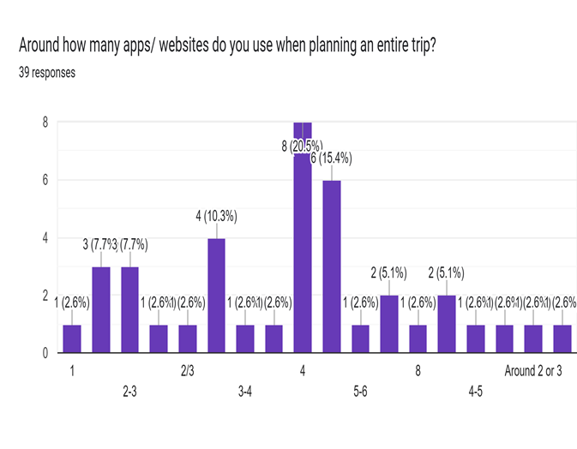
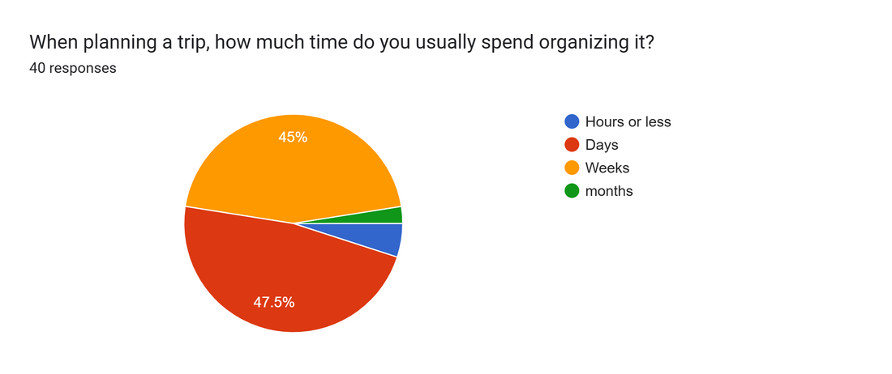

Slide 13
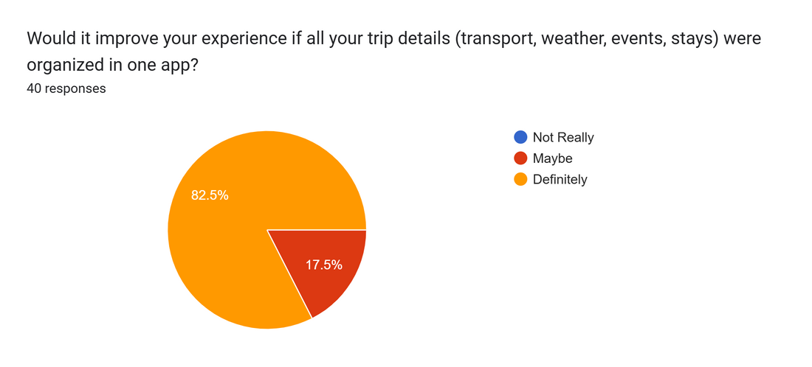
Strong Market Validation
Results validated the need for an all-in-one approach to travel planning; users want to avoid switching between several apps.

Slide 14

Persona Development
Based on the data collected from the questionnaire, the following 4 personas were created to achieve a more user-centric approach to the design of our app.

Slide 15


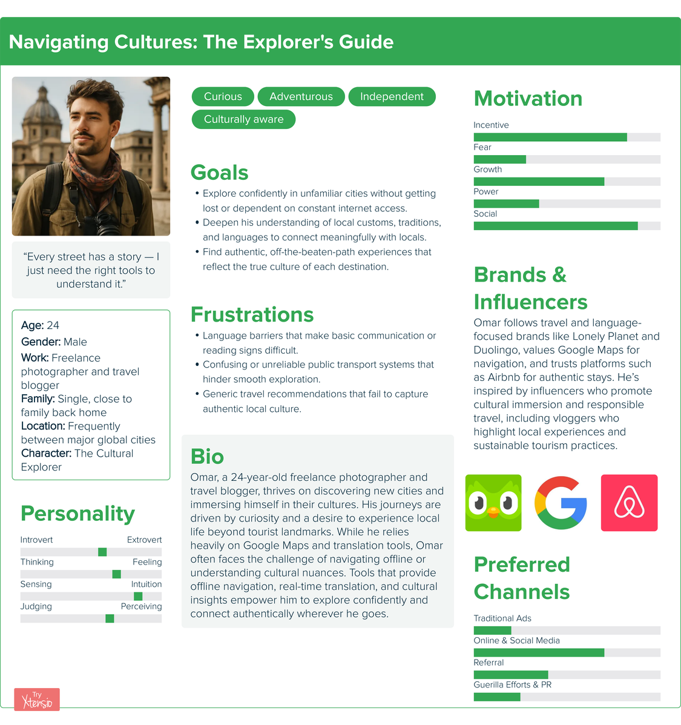

Persona
Scenario
Omar wants to find an authentic, off-the-beaten-path leather tannery deep within the old city (medina) of Marrakech. Frustration: Language barriers and confusing, unreliable public transport hinder deep cultural exploration.
Omar is exploring Marrakech. He wants to visit a specific, small, and highly recommended lplace mentioned by a local vlogger he trusts. This location is not listed on standard tourist maps and requires navigating a maze of unmarked, narrow alleys within the ancient medina. He knows his cell service will be patchy, if available at all, once he dives deep into the city's core, worried about where he will end up.

Slide 16
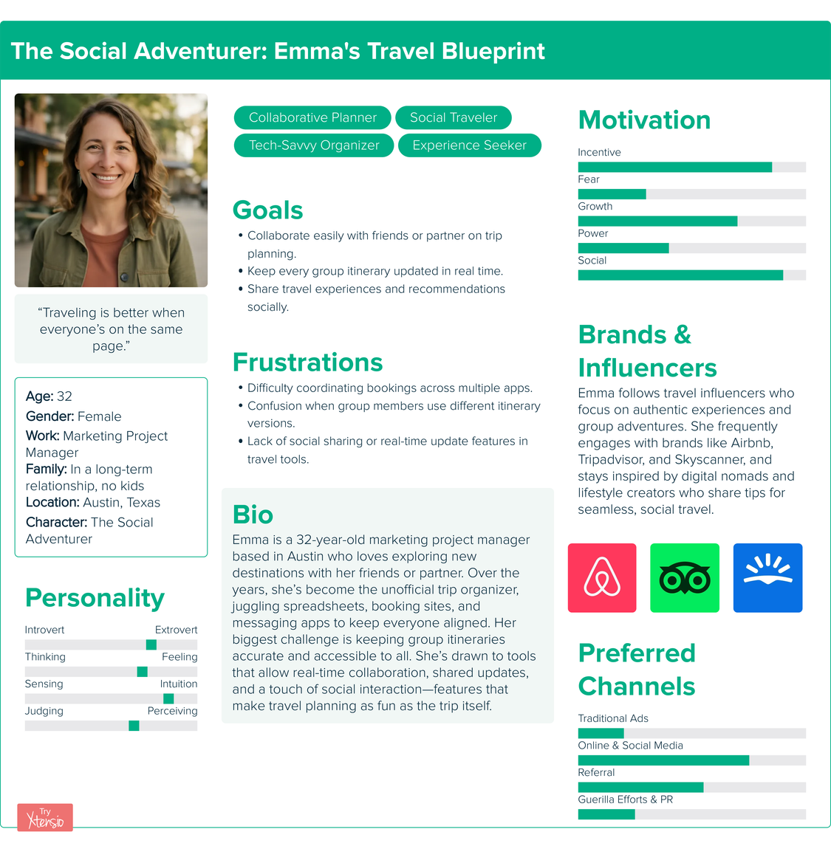
Persona
Scenario
Emma and her three friends are scheduled to take a pre-planned, hour-long Yoga class at 3:00 PM today in Ubud, which is already logged in the group itinerary. They have just finished lunch.
One of Emma's friends sees a highly-rated post on Instagram about an impromptu group beginner surf lesson starting at 3:30 PM at a beach. The group chat explodes with excited messages from everyone wanting to ditch the yoga for the surf lesson. The original yoga plan, the new surf activity details, and the required transportation change are now scattered across the itinerary app, Instagram, and WhatsApp.

Slide 17
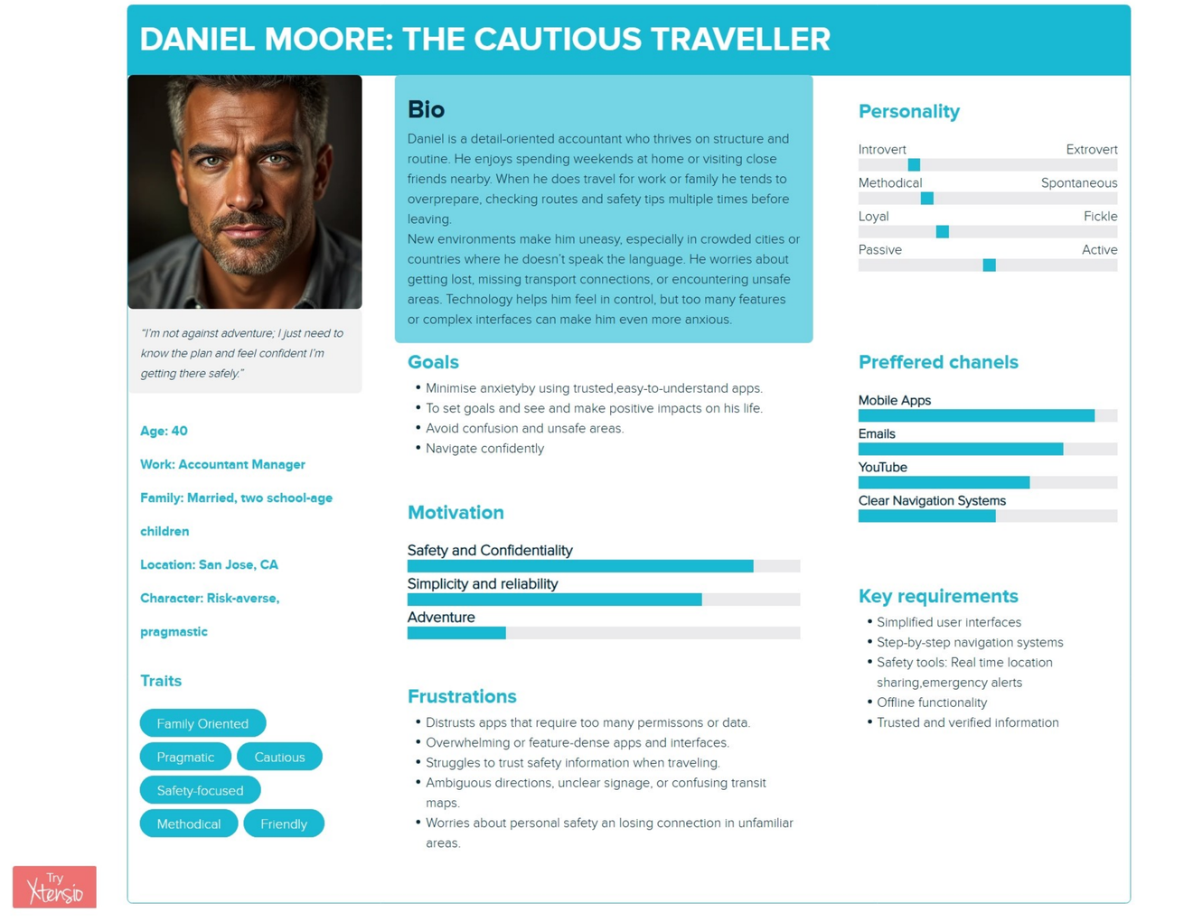
Persona
Scenario
Daniel Moore is a young professional who’s excited about an upcoming family trip. One evening, he sits at his desk trying to organize everything, flight tickets, hotel bookings, maps, schedules, and restaurant ideas. But with so many tabs and apps open, the information becomes tangled and overwhelming. He feels stressed, realizing he might miss something important. While trying to sort through the chaos on his phone, Daniel discovers an app called TripSync, an all-in-one travel organizer.
Curious, he downloads it. , he’s impressed: everything he needs for the trip reservations, schedules, maps can be stored and synced in one place. Feeling relieved, Daniel sits comfortably on his couch and starts adding all the details into TripSync.
The app automatically organizes his itinerary, helps him confirm bookings, suggests helpful reminders. For the first time that week, he feels in control of the trip. His family feels more relaxed knowing Daniel has everything handled. Once they reach the city, Daniel uses the app’s built-in navigation to guide his family through busy streets, helping them find key locations, restaurants, and landmarks safely and easily.

Slide 18
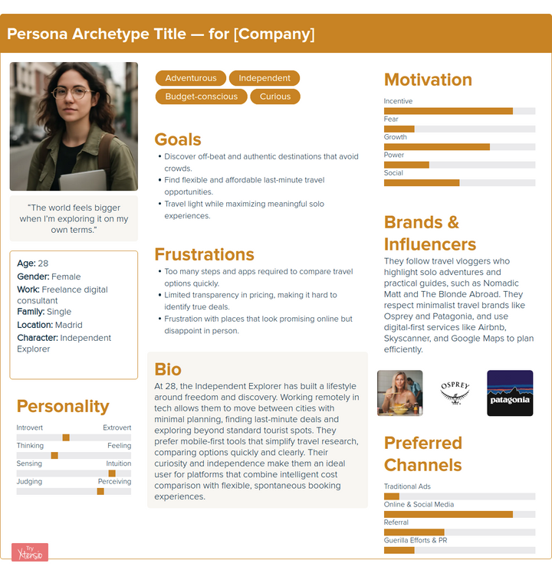
Persona
Scenario
The Independent Explorer
Sofia, a 28-year-old freelance digital consultant living in Madrid, has just finished a big project on Thursday evening. She has a free weekend ahead and wants to take advantage of a last-minute travel opportunity to explore somewhere new without spending too much.
Friday morning, Sofia wakes up feeling craving adventure. She remembers seeing a travel vlogger explore Porto's hidden cafes and colorful streets. She decides to book a spontaneous weekend trip leaving the next day.

Slide 19
Method 2: Interviews

Slide 20
WHY
HOW
Interviews help us gain deeper qualitative insights, by allowing us to ask open ended questions that aim to explore their habits and motivations.
Human emotions and pain points can be uncovered more effectively through direct conversations where questions can be rephrased and clarified.
8 interviews were conducted.
All articipants were informed that their data was being recorded purely for academic research purposes before the start of the interview sessions.
The interviews were analysed and the patterns that dominated extracted.

Slide 21
A few snippets....
Sumavia: Q. "Which travel tools (like apps, websites, local guide etc.) do you rely on the most? What
features do you like about them and is there anything you wish they could do better?"
Person B: A. "I don't like apps lol, I don't even use the DB app. Instead I just go to the Hauptbahnhof
to buy my tickets. My Deutschlandticket is a physical card, like an EC card or whatever
I currently have a Bahncard and that's a printed piece of paper. I don’t like relying on
technology. Cause you need wifi for most of those, and that's not a guarantee when
you're on a train.
I don't want to accidentally have an invalid ticket for no reason"
Melek: Q."How do you keep track of your plans?"
Serap Kaçmaz (23): A. "Apps that show reviews, contact info, and all necessary details about the places she wants to visit—these make things easier."
Melek: Q. "What stresses you most when traveling/planning?"
Serap Kaçmaz (23): A. "Time loss and things not looking like what was advertised."
Sumavia: Q. "What do you feel like causes you the most stress? either while planning your trip or
during your trip
Person A
Person A: A. Deadlines, so having to plan and book earlier enough to avoid paying too much;
deciding which clothes to bring hahah according to the weather, especially if it's a totally
new place for me; balancing my finances during the trip hehe it's so tempting to go and
try new things, food etc. so it's quite tricky to experience the most and also buy
souvenirs etc. but paying attention to the expenses as well
Oh! and the airport security checkpoints haha"
Melek: Q. What wastes the most time on a trip?
Özlem Tuzlu (44): A."Taking notes (using a notebook)."

Slide 22


and insights
Current User Behaviour
Main Pain Points
Design Opportunities
Trip Planning
Users often rely on Google Maps, Google Calendar, physical planners, or travel apps that compare hotels.
Time Wasted
Searching for routes or activities.
Switching between apps to gather info.
Checking reviews manually.
Unified Travel Planner App
Transportation planning
Activity suggestions &Reviews
Notes and Reminders
Reliable Ticket QR codes
AI Travel Assistance
Mixed opinions
Some are very positive.
Some are negative (fear of wrong directions).
Some are open but cautious.
Fragmented Travel Information
Users must switch between:
Google Maps
notes
calendars
ticket instructions
Leads to confusion and inefficiency.
AI Itinerary Generator
Automatically creates:
Day-by-day routes
Travel time estimates
Nearby points of interest
Adjusts dynamically if plans change
Travel Interests
Some users want to discover local cuisine, others want comfort and convenience, some want historical background of places.
Transportation Problems
Switching between different trains and apps is tiring.
Streetlights/traffic or long connecting waits waste time.
Heavy dependency on digital maps → if internet fails = chaos.
Reliable Route Mode
Guaranteed accurate routes
Offline maps, build trust between users and digital navigationStep-by-step guidance
Warnings for disruption

Slide 23
04. Task Planning & Analysis

Slide 24
User Goal: Stress Free Planning
Pain Point: Wasting time
Feature: AI itenerary Generation (Plan)
WORK FLOW
User selects of interests ⟶AI Generator suggests activities based on interests and reviews ⟶ User reviews itenerary, edits plan, chooses preferred transportation options ⟶ User confirms plan⟶ App produces an offline map copy.

Slide 25
User Goal: Reliable navigation
Pain Point: Transportation problems
Feature: Map API and AI integration (Navigate)
WORK FLOW
User enters destination or selects location on pre made plan⟶Fastest most accurate route is displayed⟶App provides step by step guidance through real-time location tracking⟶Automatic warning signals and redirection

Slide 26
User Goal: Quick Data Access
Pain Point: App fragmentation
Features: Booking ,Ticket storage , notes & blogging area
WORK FLOW
User opens app⟶ navigates to plan view to access routed itenerary⟶ navigates to booking area to access tickets⟶ Checks notes for updates in plan or personal details ⟶ Access transportation details ⟶ Check reviews for selected destination.

Slide 27
User Goal: Find Optimal Activities Nearby
Pain Point: Places to go
Feature: AI Generator (Discover)
WORK FLOW
User is at a location⟶App uses the user’s pre-set Travel Interests and filters nearby points of interest and activity suggestions⟶User views results organized by travel time and quality of reviews⟶User selects an activity⟶App initiates navigation using the Reliable Route Mode.

Slide 28
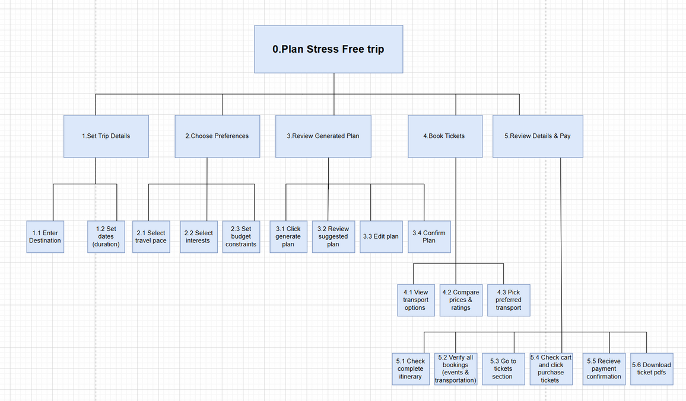
Plan 0: Do 1-2-3 in sequence, then 4-5-6 as needed (cycle)
Plan 4: Do 4.1-4.2-4.3 in sequence
Plan 1: Do 1.1-1.2 in sequence
Plan 2: Do 2.1-2.2-2.3 in any order
Plan 3: Do 3.1, wait for generation, then 3.2 -3.3 (optional) -3.4
Plan 5: Do 5.1-5.2 -5.3-5.4-5.5-5.6 (optional) in sequence)

Slide 29
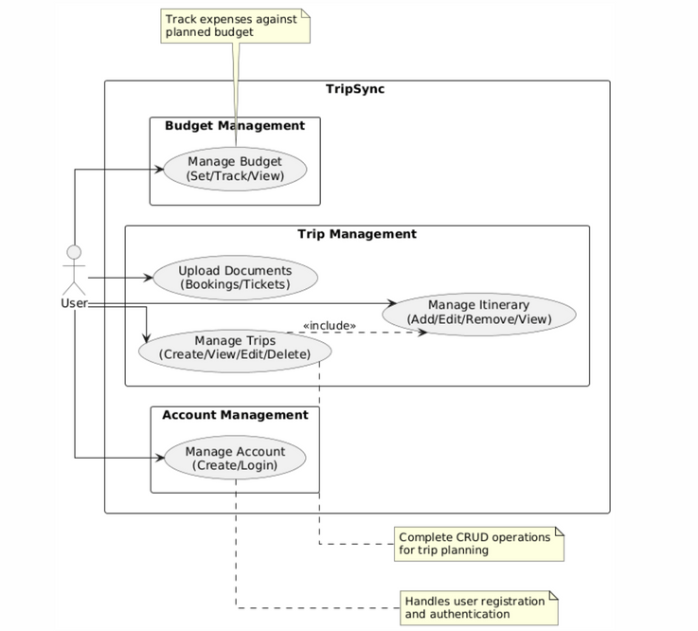
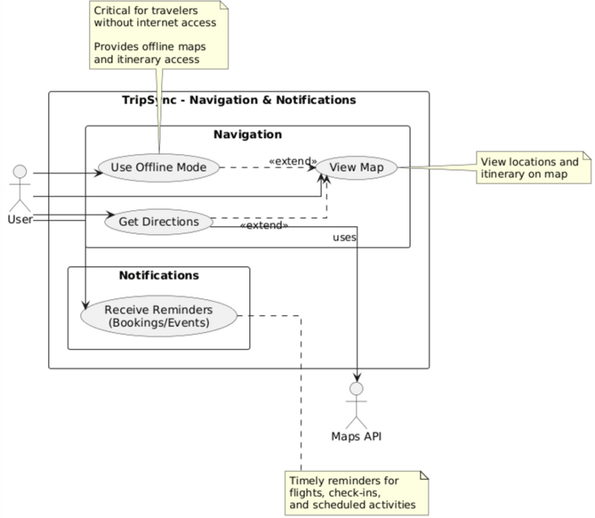
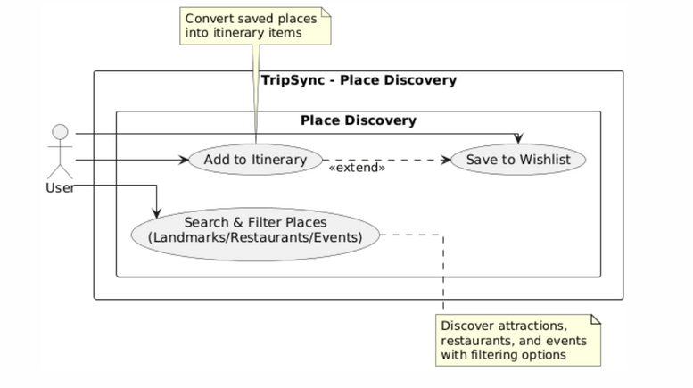

Slide 30

05.Requirements Specification: Functional, Non- Functional,
User Experience

Slide 31
Some Conclusions..
Based on data collected from both questionnaires and interviews, the desire for the following features were inferred:
An all-in-one integration
Local/traveller recommendations
Itinerary management and documenting
Budget filtering
Cultural/historical context about destinations
Potential users showed the need for better organization of attractions, local recommendations, and contextual information (history, prices, cultural aspects)

Slide 32
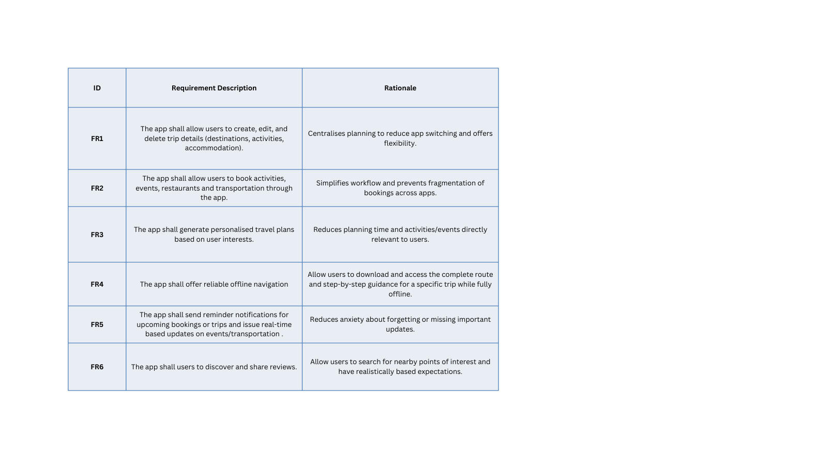
Functional Requirements

Slide 33
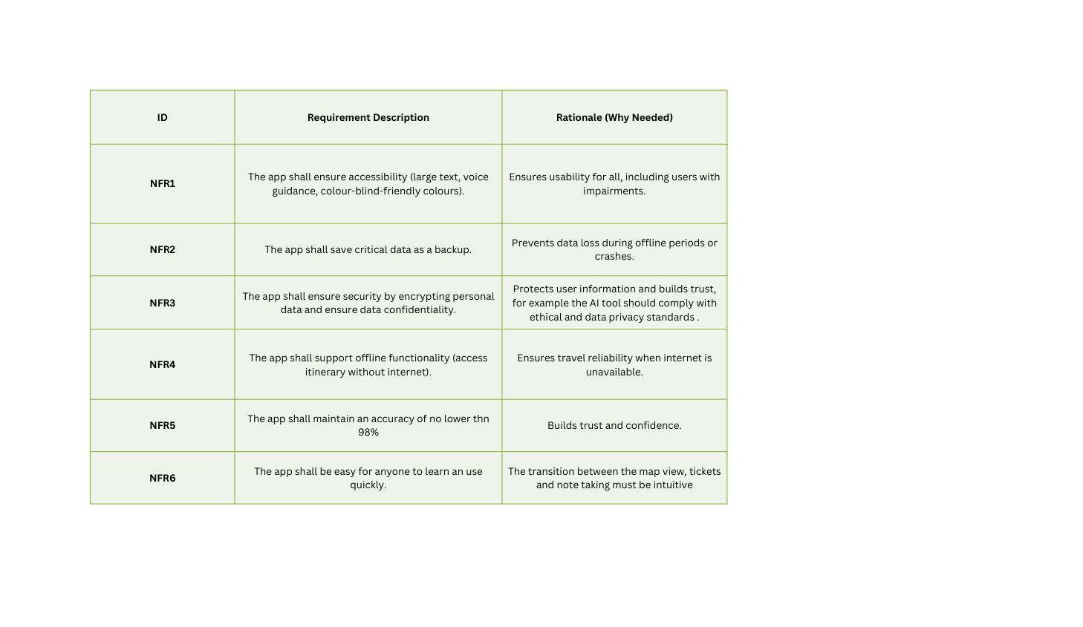
Non- Functional Requirements

Slide 34
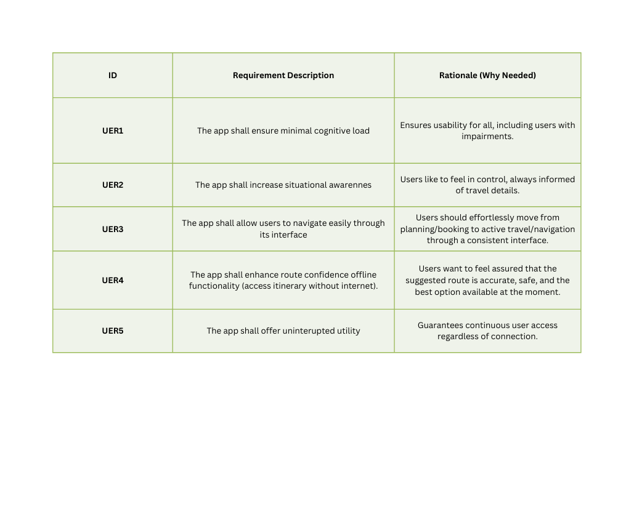
User Experience Requirements

Slide 35
06. Appendix

Slide 36
Interview Transcripts :
https://docs.google.com/document/d/1ItRSgnZXXO-i-8wyfGpQPMdtuSYNYTpx7uZDRBzIWf8/edit?usp=sharing
Questionnaire link and Responses:
https://docs.google.com/forms/d/e/1FAIpQLScCkAj6R40nkUIedPwUN__pmRisjKrR4Lkwsc_RBP-ZLQKx7g/viewform?usp=header

